Slide 1


Slide 2
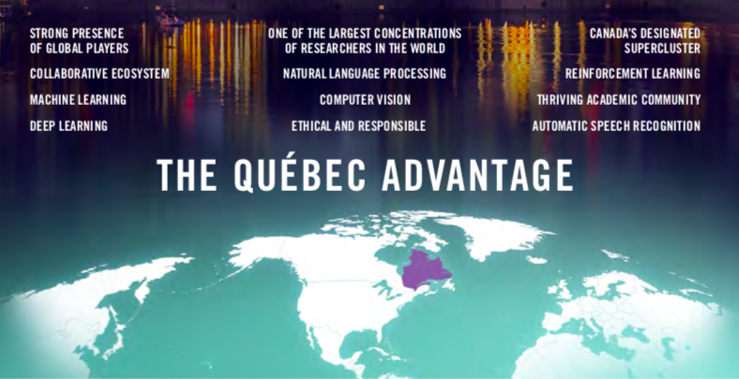

Slide 3
Major public investment
$93.6 M from the First Research
Excellence Fund (2016)
_____________________________________
$100 M over the next 5 years for the
creation of a Québec AI cluster
(2017)
_____________________________________
$40 M over the next 5 years for the
creation of a Québec AI cluster
(2017)
________________________________________________________
Montréal chosen as headquarters for SCALE AI
the only Canadian AI cluster to receive part of the
$950 M supercluster initiative (2018)
_____________________________________
$329 M over the next 5 years to
accelerate the adoption of AI
in Québec (2019)

Slide 4
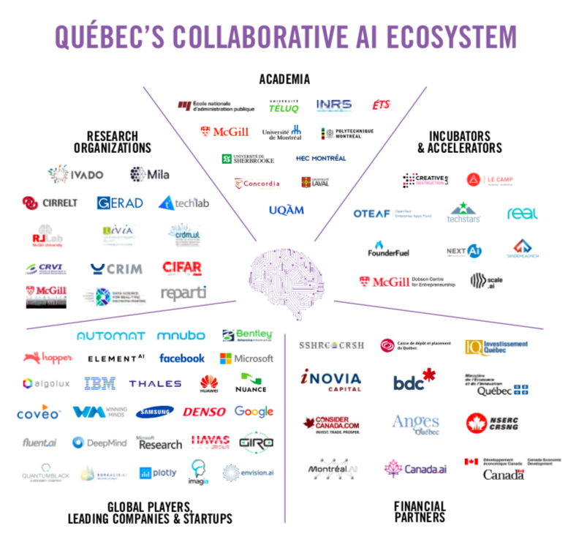

Slide 5
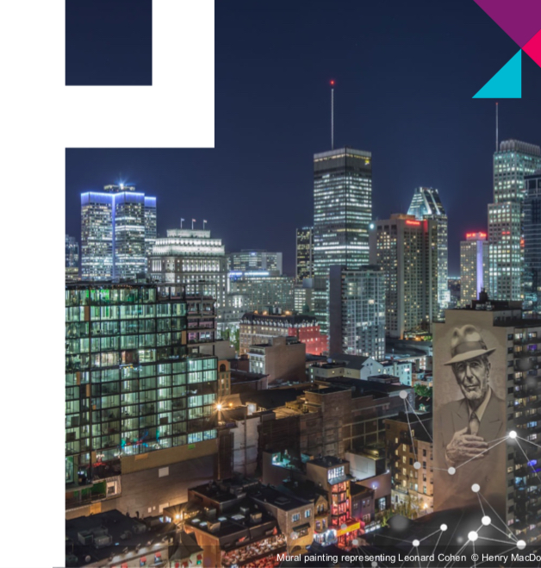
Montreal : a booming World-Class Artificial Intelligence Hub

Slide 6
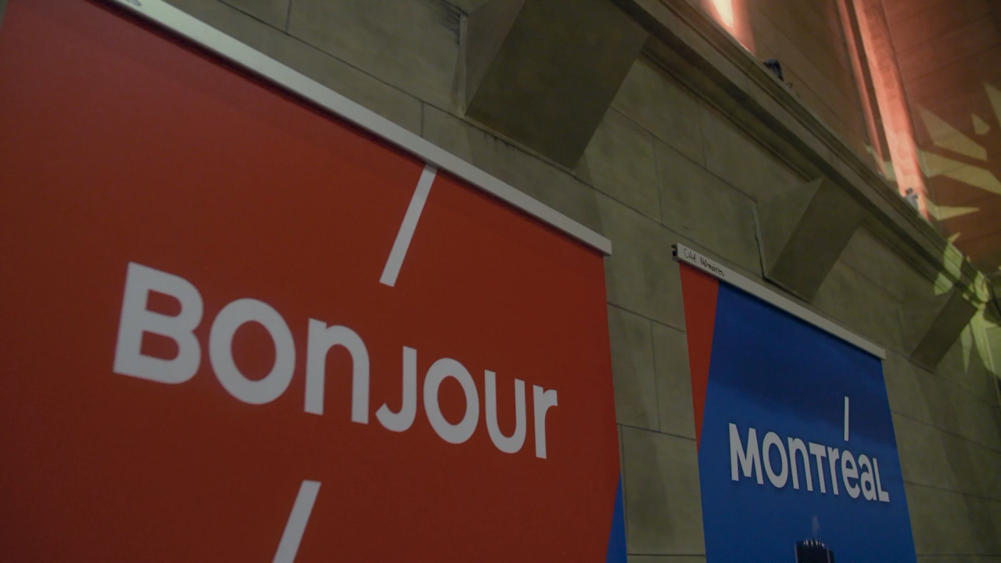

Slide 7
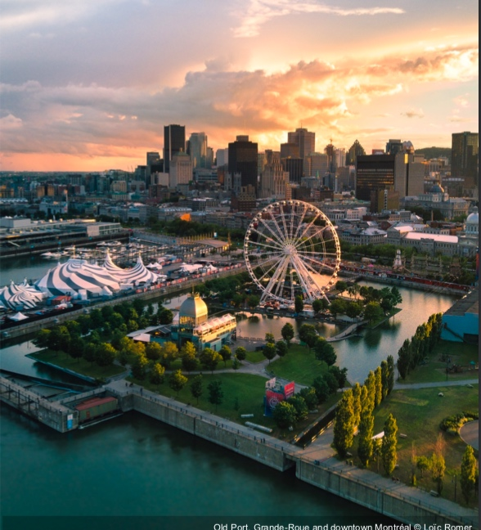
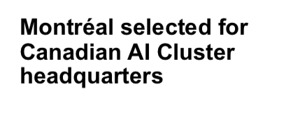
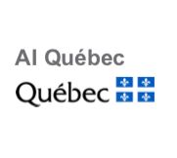



Slide 8
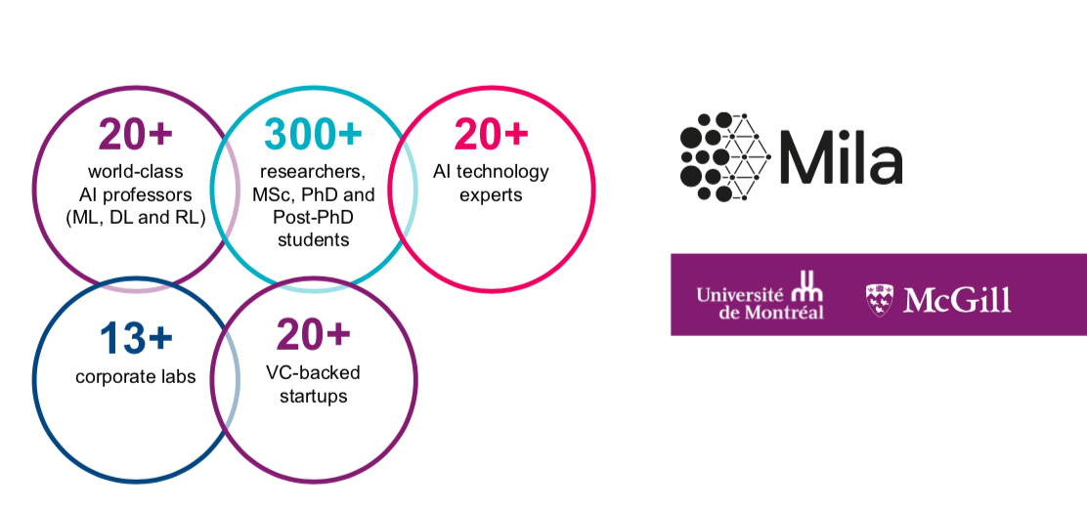

Slide 10
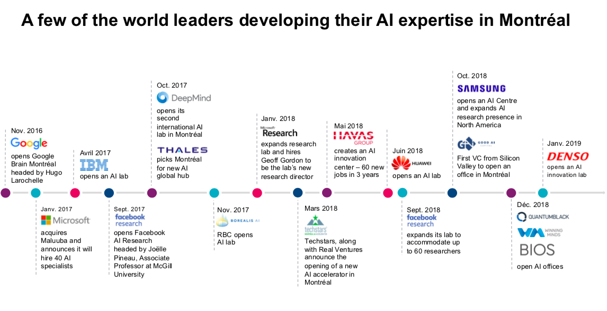

Slide 11
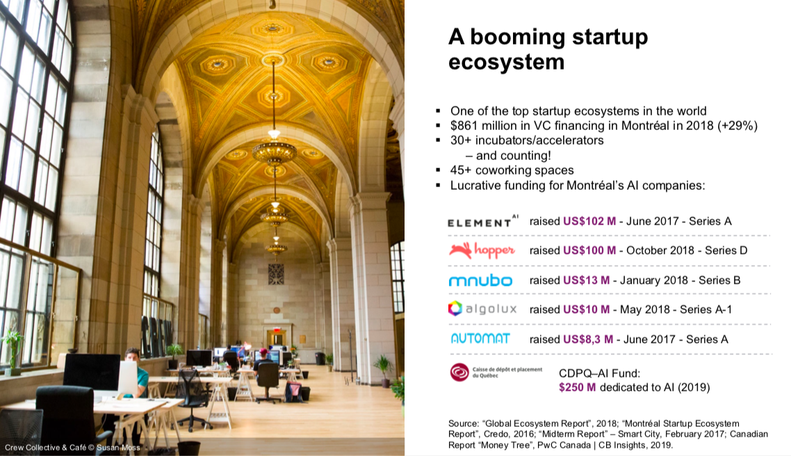

Slide 12
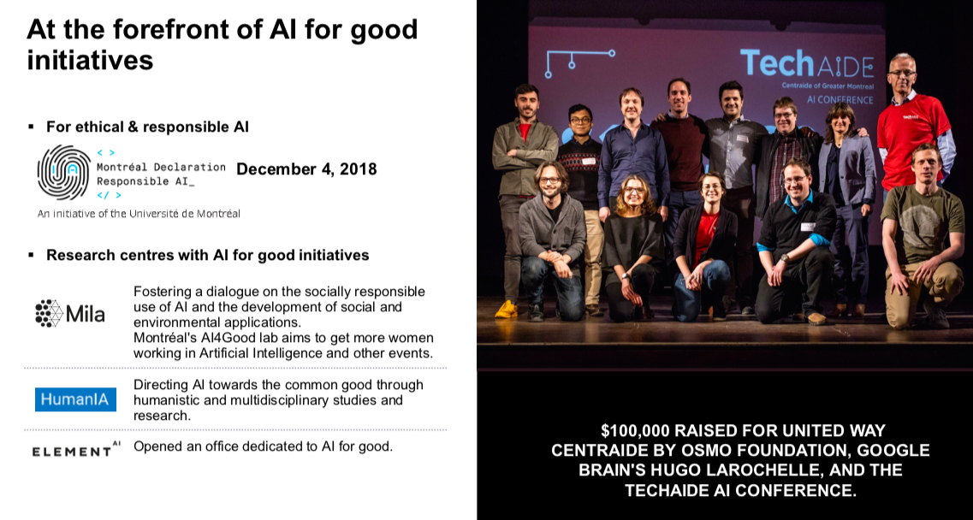

Slide 14
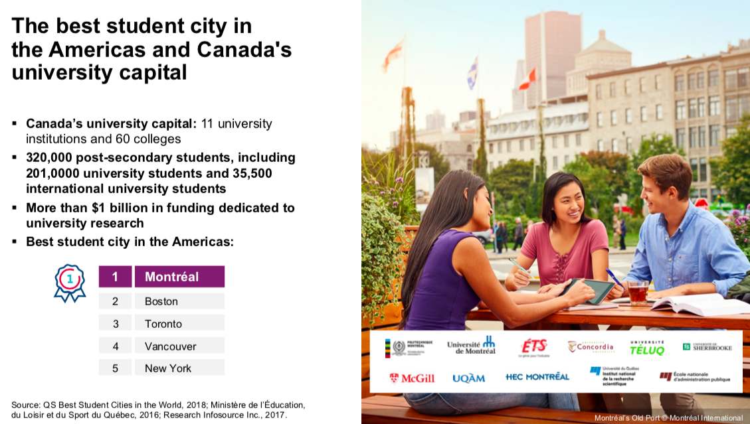

Slide 15
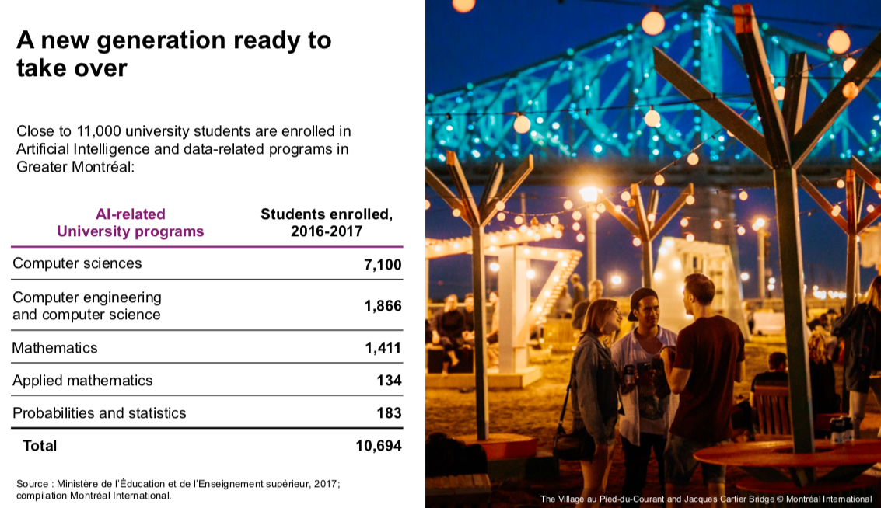

Slide 16
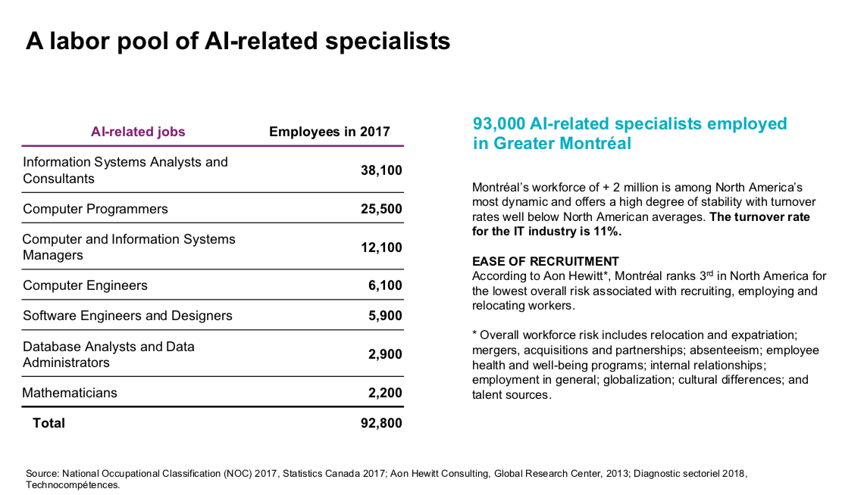

Slide 17
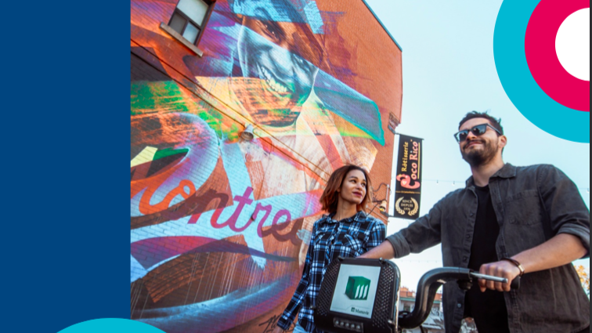
Attractive Operating Costs and incentives

Slide 18
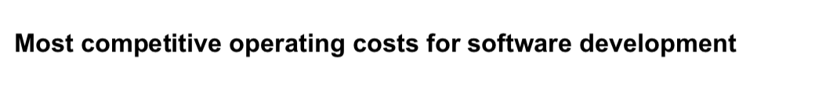
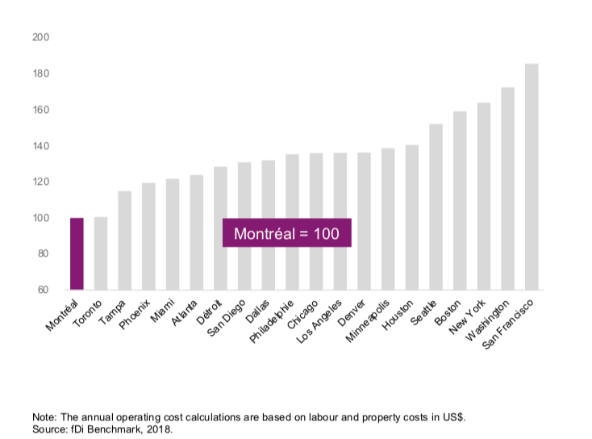

Slide 19
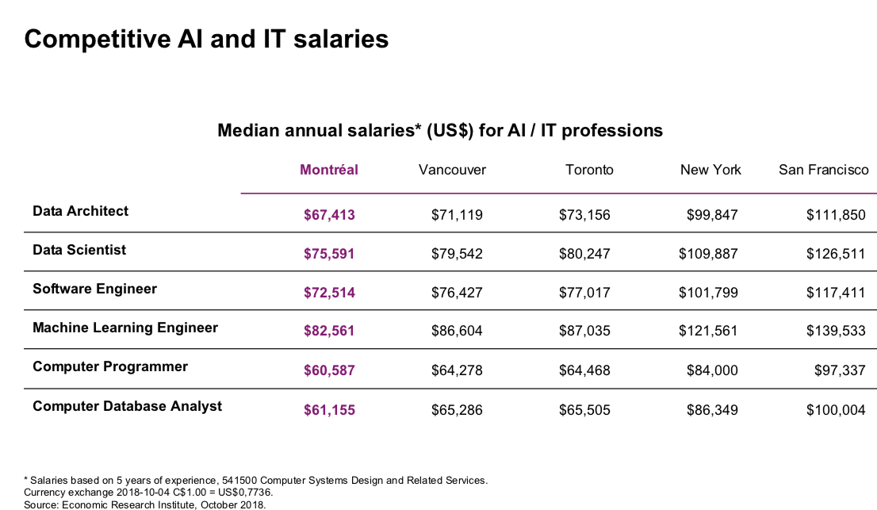

Slide 20
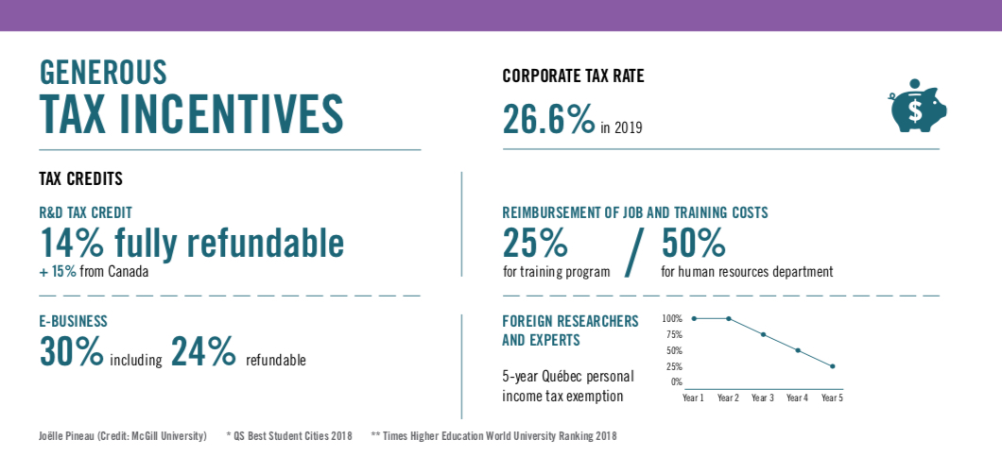

Slide 21
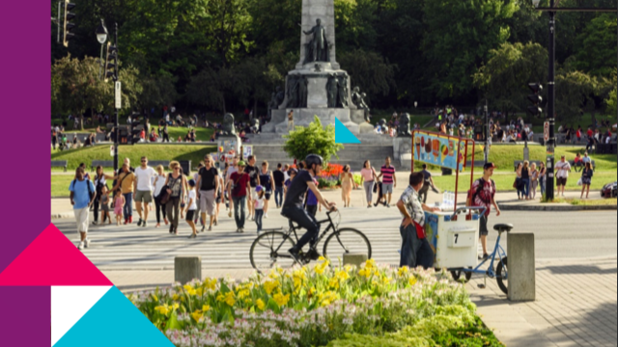
An Exceptional Quality of Life

Slide 22
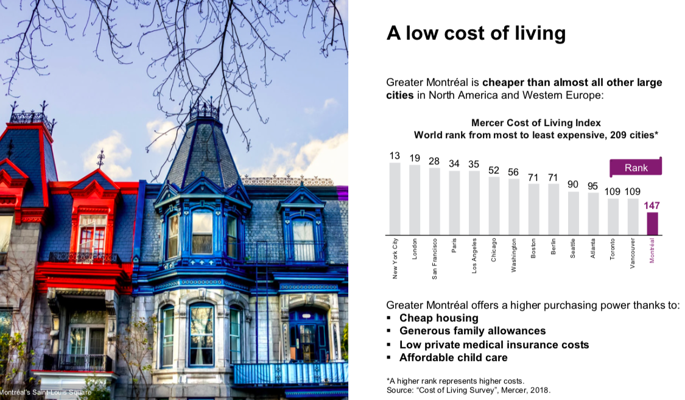

Slide 23
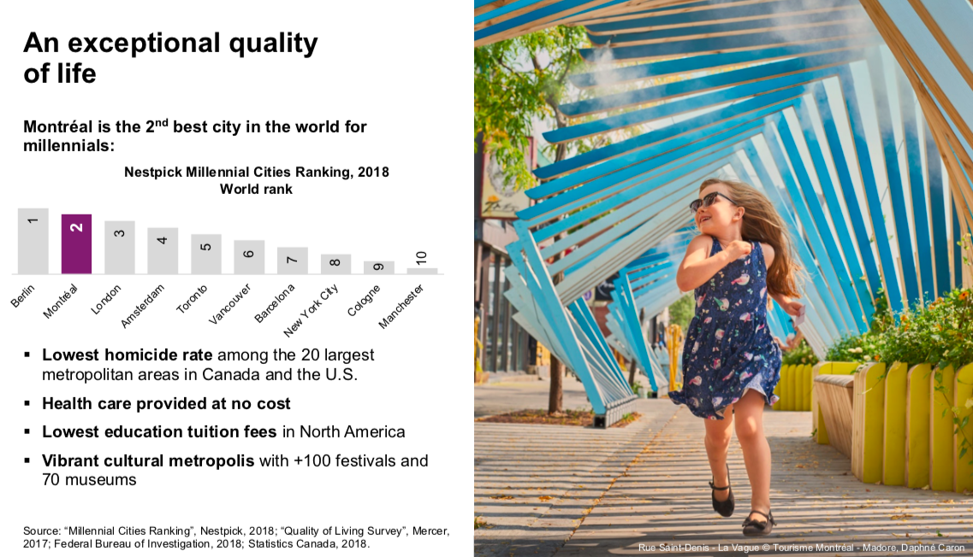

Slide 24
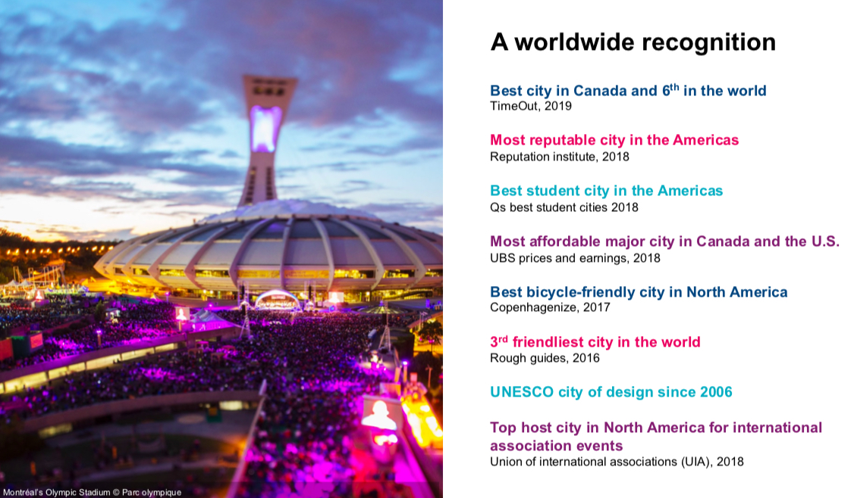

Slide 25

THANK YOU!

